Slide 1
Energy Types & Transformations

Slide 2
STORED ENERGY
GRAVITATIONAL POTENTIAL ENERGY
CHEMICAL ENERGY
ELASTIC ENERGY
NUCLEAR ENERGY

Slide 3
ENERGY IN ACTION
KINETIC ENERGY
ELECTRICAL ENERGY
SOUND ENERGY
HEAT & LIGHT ENERGY

Slide 4
Using Energy
What does it mean to Use Energy?
Energy in the universe cannot be created or destroyed!
Energy can only be transformed from one type to another.
To Use Energy really means to Transform Energy
Note: All energy in the universe is eventually transformed into heat.

Slide 5

Energy Transformations:
Example: hand-powered dynamo
Chemical potential energy
(in muscles)
Kinetic
Energy
(of hand, wheel and gears)
Electric energy
Light
Energy
(desired output)
Sound energy
(undesired output)

Slide 6
A Falling Book
Explain how the four previous forms of energy are displayed by a falling book.
Gravitational Potential
Kinetic
Sound
Thermal

Slide 7
Energy Transformations
All events in the universe involve energy transformations.
One type of energy being converted into another type of energy.
How many energy transformations were observed in the falling book?

Slide 8
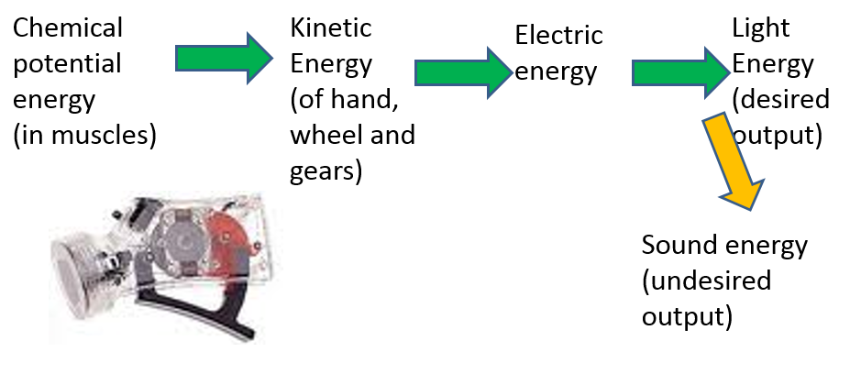
Other Common Forms of Energy
Chemical Potential Energy
Energy stored in chemical bonds
Electrical Potential Energy
Energy associated with electrical charges
Nuclear Potential Energy
Energy stored in the nucleus of an atom
Radiant Energy
Energy of electromagnetic waves
What types of energy transformations happened in something you did this morning? (Draw a transformation arrow diagram)

Slide 10
Other Common Forms of Energy
Chemical Potential Energy
Energy stored in chemical bonds
Electrical Potential Energy
Energy associated with electrical charges
Nuclear Potential Energy
Energy stored in the nucleus of an atom
Radiant Energy
Energy of electromagnetic waves
What types of energy transformations have you used so far this morning?

Slide 11
Consolidation Question
Think about something you did to get ready for school this morning.
Briefly summarize the activity.
List the different types of energy you used and how you transformed (used) the energy.
Draw an Energy Transformation Diagram for your morning activity.

Slide 12
Forms of Energy
Chemical Potential
During chemical reactions when bonds are formed or broken
Sound
Vibrations, which travels as waves
Radiant
Electromagnetic spectrum, have characteristics of waves
Nuclear
Nuclear reactions called fusion, fission
Electrical
Electrons in an electrical circuit
Thermal
Rapid movement of molecules and atoms of a substance
Gravitational
A raised object due to its position above some reference level
Kinetic
Moving object, or energy of motion
Elastic Potential
Stored energy or stretched or compressed energy

